Slide 1

Cloud Log Monitoring System
By,
Shreya Kumari (fd6317)
Richa Sapre(ee9498),
Cloud Computing

Slide 2

MODERN APPLICATIONS GENERATE MASSIVE LOG VOLUMES
MANUAL LOG COLLECTION IS INEFFICIENT AND ERROR-PRONE
Real-time log collection
Secure storage & analysis
Alerts for faster issue resolution

Slide 3
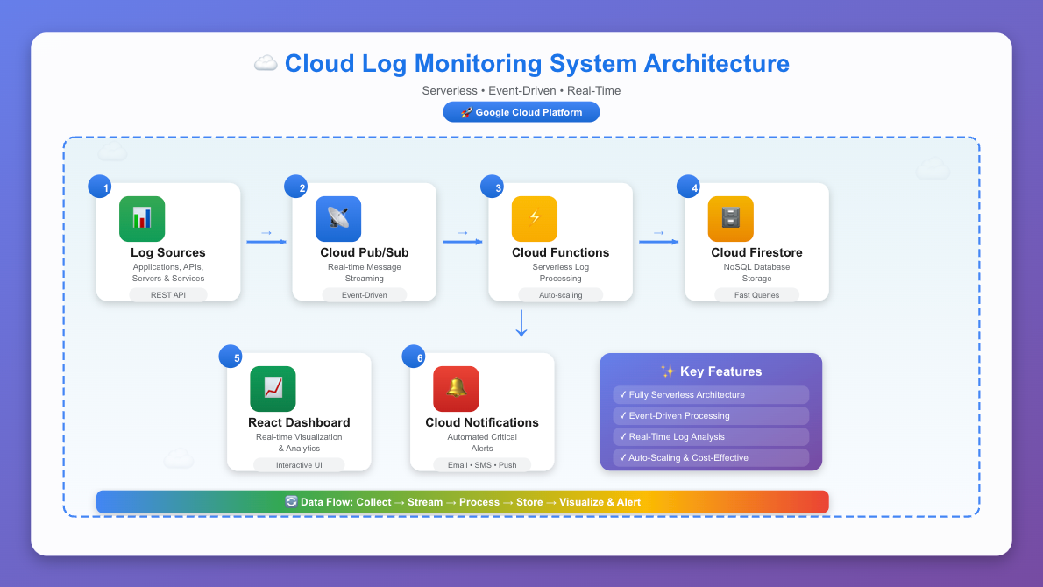
Cloud Architecture Overview

Slide 4
Solution Overview
A fully serverless, event-driven Cloud Log Monitoring System
Built on Google Cloud Platform (GCP)
Collects, processes, stores, and visualizes logs in real time
Includes automated alerting for critical logs

Slide 5



System Architecture
Steps illustrating the architecture of the system
Collection
Streaming
Processing
Client Applications
Cloud Run API
Pub/Sub Topic
Cloud Function
Storage
Web Dashboard
Firestore Database
Alerts
Visualisation
Gmail SMTP Alerts

Slide 6



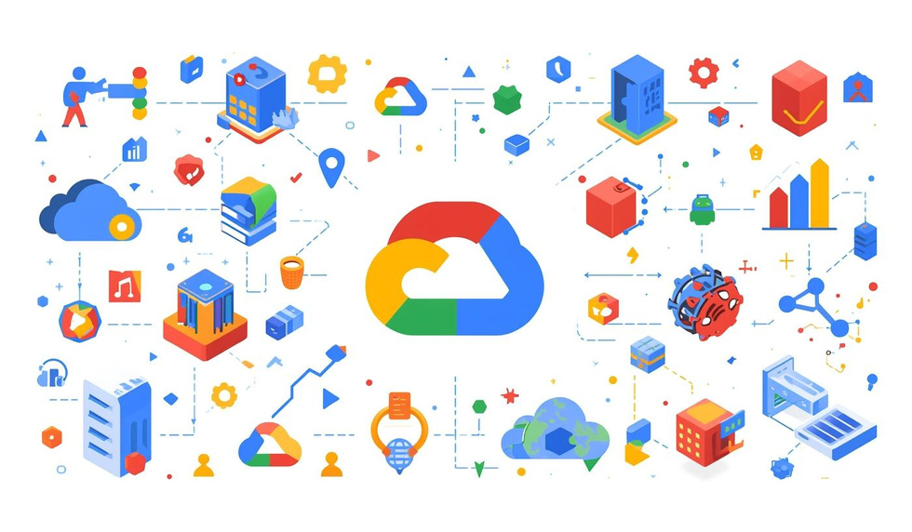
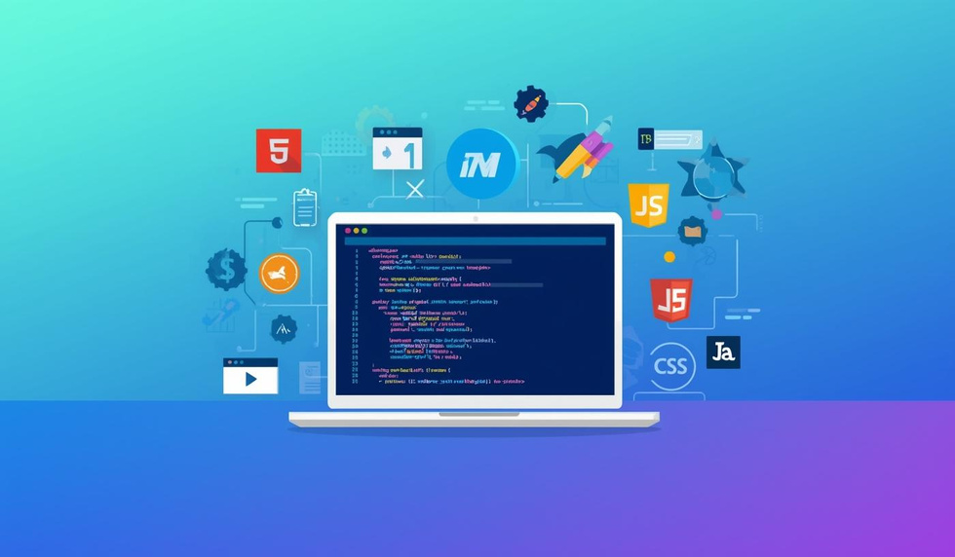
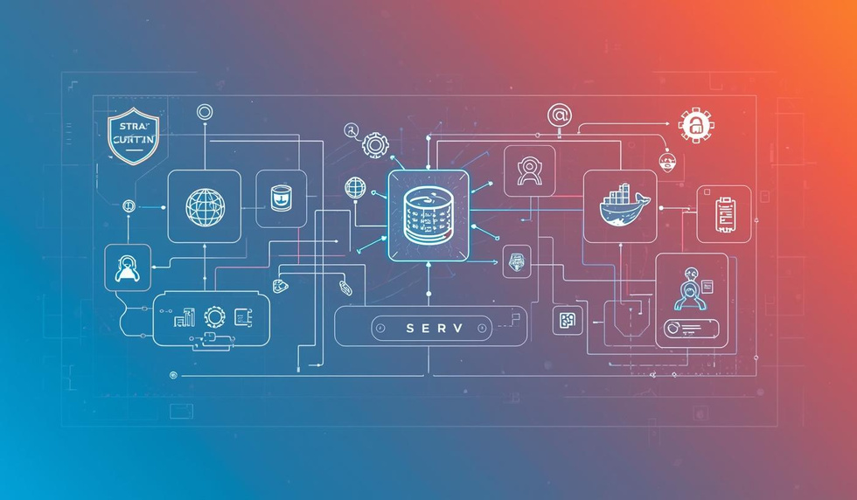



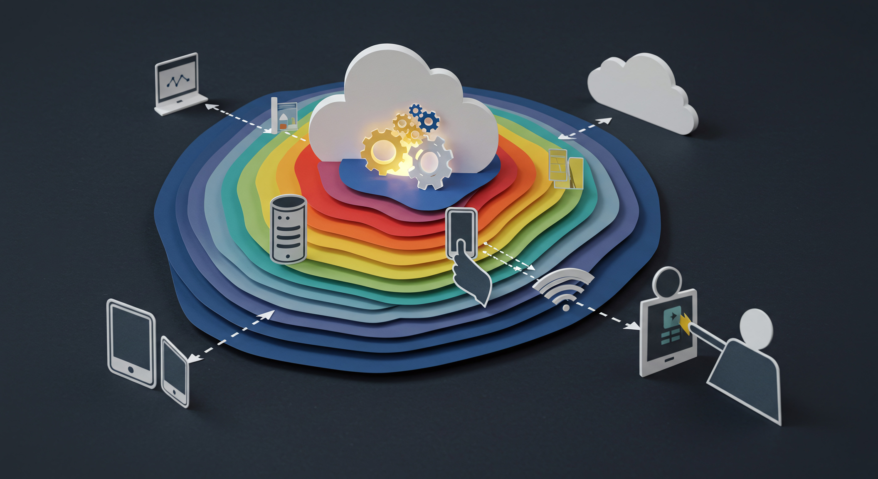


Technologies Used in Cloud Log Monitoring
CLIENTS POST LOGS TO CLOUD RUN API (API.PY)
API PUBLISHES LOGS TO PUB/SUB 'LOGS-TOPIC
CLOUD FUNCTION PROCESSES LOG EVENTS
LOGS STORED IN FIRESTORE NOSQL
DASHBOARD QUERIES FIRESTORE
GMAIL SMTP ALERTS FOR ERROR/CRITICAL VIA CLOUD FUNCTION — MINIMAL ICONS, VERTICAL FLOW

Slide 7
Tech Stack
FRONTEND
BACKEND
GOOGLE CLOUD SERVICES
HTML, CSS, JavaScript
Chart.js for visualization
Python 3.10, Flask, Flask-CORS
Docker, Cloud Run
Firestore
Cloud Storage
IAM
Cloud Logging
Pub/Sub
Cloud Functions
OTHER
Gmail SMTP alerts
GitHub for version control
Use a multi-column icon layout.

Slide 8
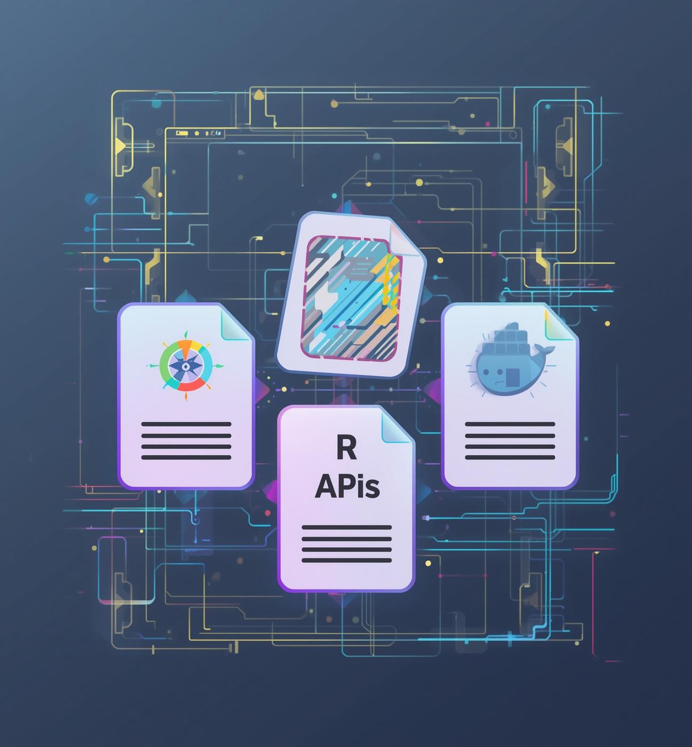
Key Features Implemented
Real-time log collection
Pub/Sub event-driven streaming
Serverless Cloud Function processing
Firestore NoSQL persistent storage
Interactive dashboard with auto-refresh
Chart.js visualizations
RESTful API (POST /api/logs, GET /api/logs, GET /api/stats)
Automated email alerts for ERROR logs
Production deployment using Cloud Run + Cloud Storage

Slide 9
Thank YOU

